Slide 1
Two-Step Email Verification: A GCP Implementation
Presented by: Oluwatomisin Taiwo, Prathyusha Papysettypally, Khandakar Asef Erfan, Mahmudul Hasan, Md Ismail Hossain.
Supervised by: Jaspreet Bhatia
Assigned Project Group: 3

Slide 2
Introduction
2FA (Two Factor Authentication is a multifactor authentication method involving a second identity check in addition to the user’s password
The idea behind 2FA is that even if a hacker manages to obtain one factor, they will still need the other factor to gain access to the account.
Other types of 2FA exists such as app push notification , hardware sync tokens and biometrics
For this project OTP or on time generated pin via cloud run server clock was used that syncs to enable correct pin

Slide 3
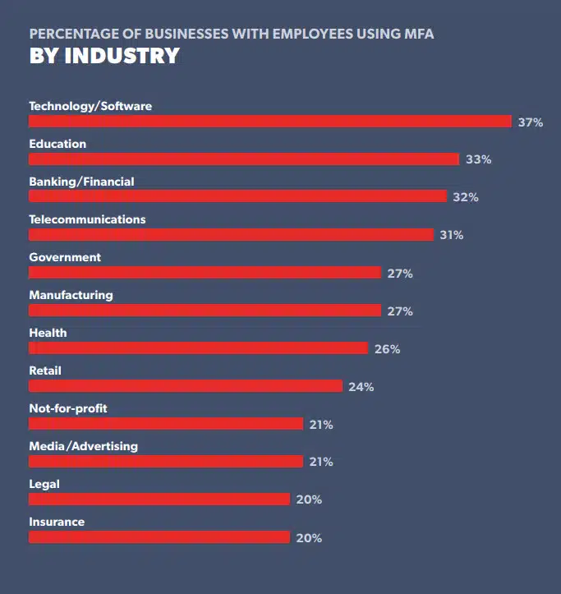
Business Prospect
Both Google and Microsoft’s multi-factor authentication statistics paint a clear picture – setting up a multi-factor authentication pretty much nullifies the chances of getting your account hacked. Since hackers do not have access to the device the authenticator app is installed on, they cannot complete the login process even if they somehow get ahold of your username and password.
In 2021, 66% of Google’s users were using 2FA to secure their accounts
Microsoft also reported that 2FA adoption has increased by 40% since 2018
LastPass reported a rise of twelve percentage points on the previous year (2020), taking the global uptake figure of businesses using multifactor authentication to 57%.

Slide 4
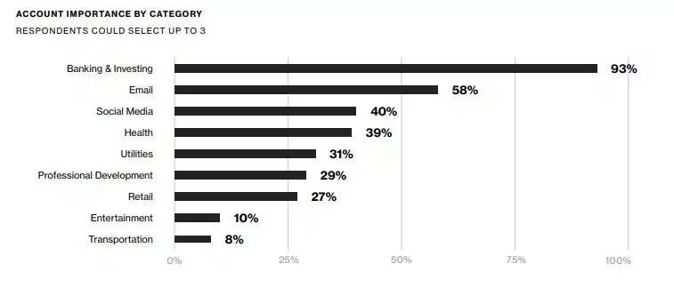
Business Prospect
Duo Labs reports that the most concerning industry were it to be hacked would be related to finance – backed by 93% of respondents. Email and social media were the following most essential categories with 58% and 40% of responses, respectively.

Slide 5
Objective and Scope
It is no surprise more and more sectors are industry are becoming heavily reliant on 2FA to protect its users
The objective of this project was to verify the feasibility of this of 2FA using Google Cloud Platform, as the increased demand of the huge increase in user count and reliability of the second factor
The demonstration also servers as a way for us to calculate cost breakdown for this project

Slide 6
Key Components in the Pipeline
While the implementation of 2FA significantly elevates the security posture, it introduces challenges related to scalability, particularly in environments characterized by dynamic user volumes and varying authentication demands.
Google Cloud Platform emerges as the ideal solution for this purpose . The principal elements constituting the pipeline's infrastructure are
App Engine
Cloud SQL
Cloud Storage ( Bucket)
Pub/Sub
Cloud Functions

Slide 7
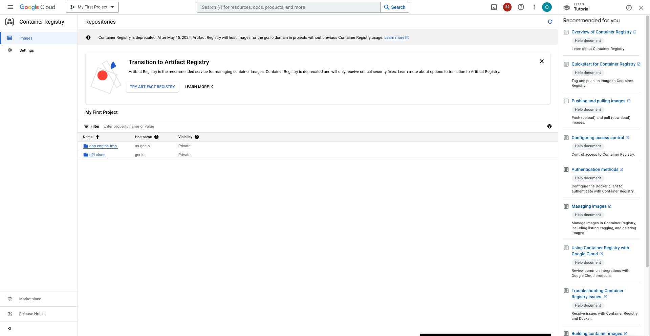
Services : Container Registry for Docker Image

Slide 8
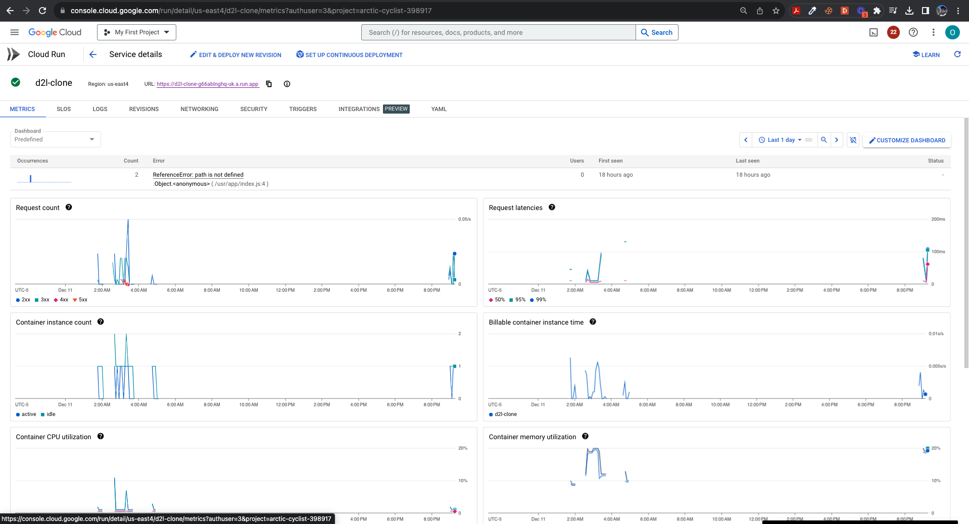
Services : Cloud Run for Front End

Slide 9
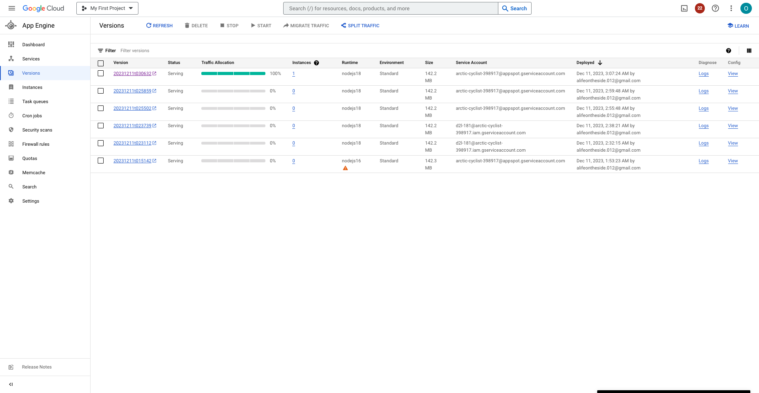
Services : App Engine for Backend Deployment

Slide 10
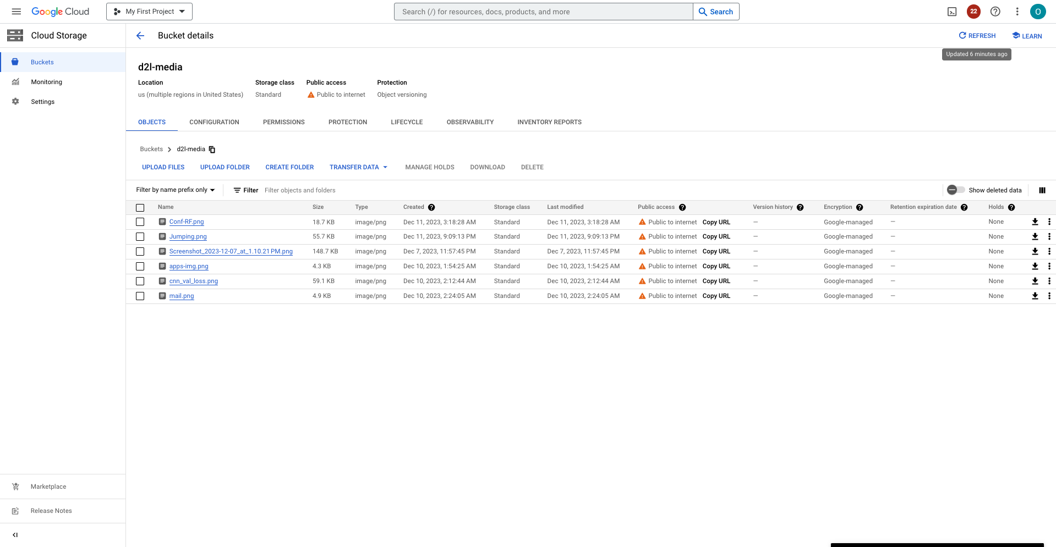
Services : Cloud Storage for hosting static media

Slide 11
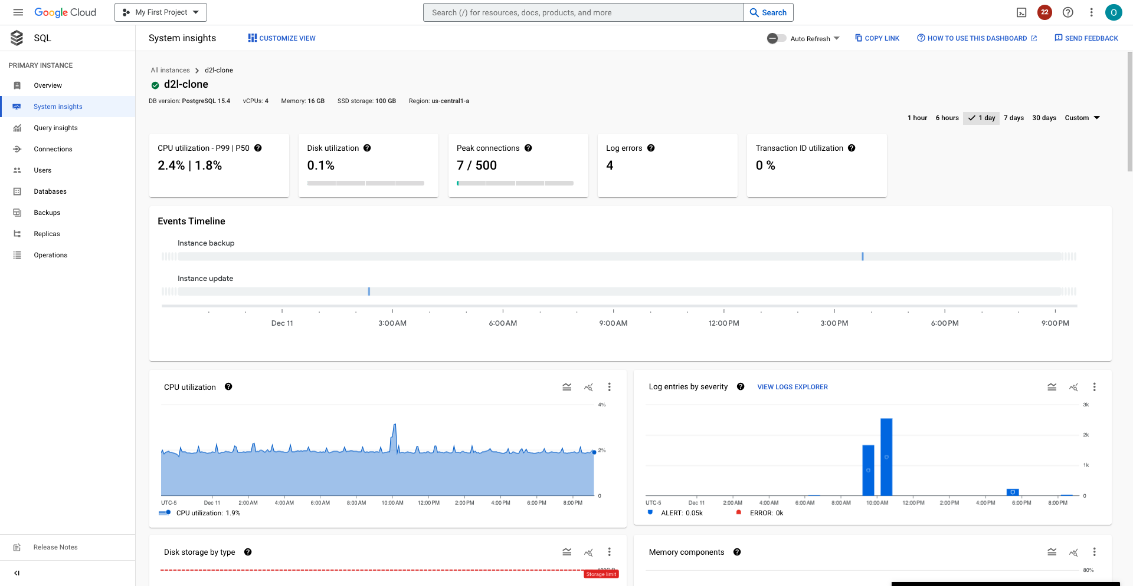
Services : Cloud SQL for Relational Database

Slide 12
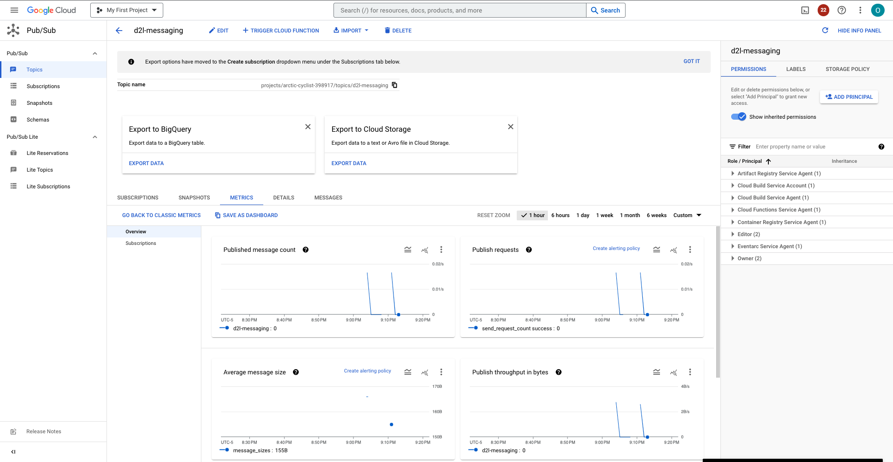
Services : Pub/Sub for Queueing Requests

Slide 13
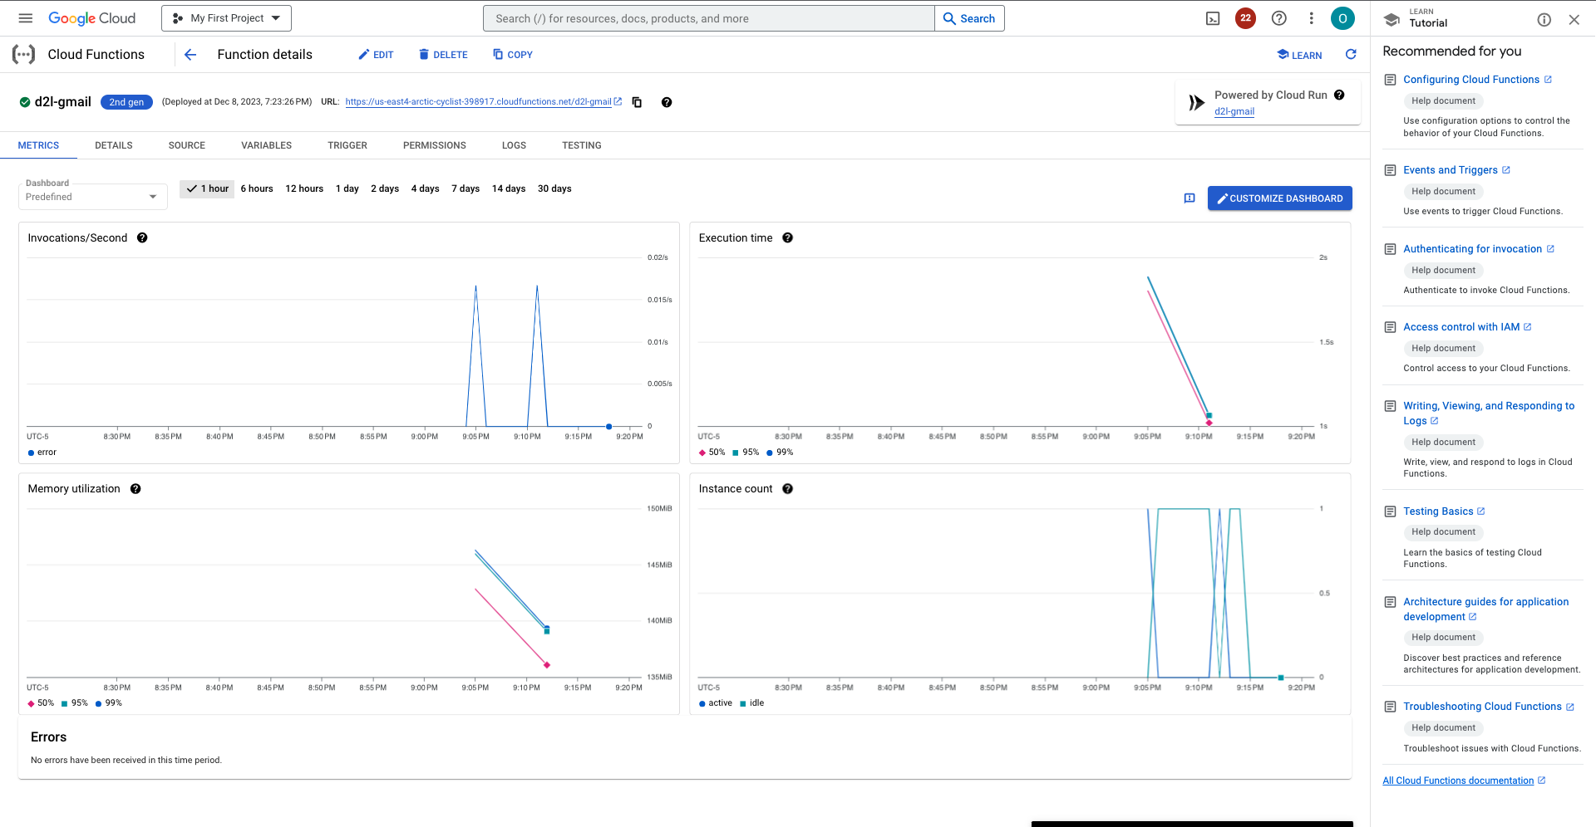
Services : Cloud Function for Delivering Email

Slide 14
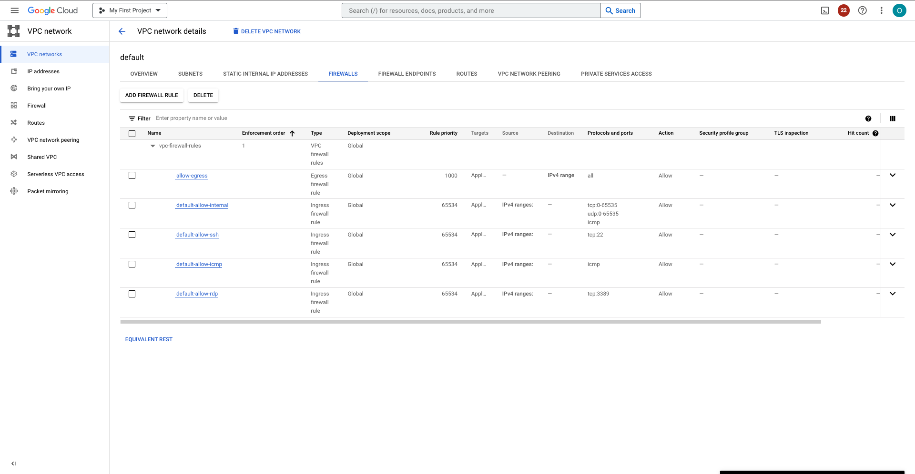
Services : Complete VPC

Slide 15
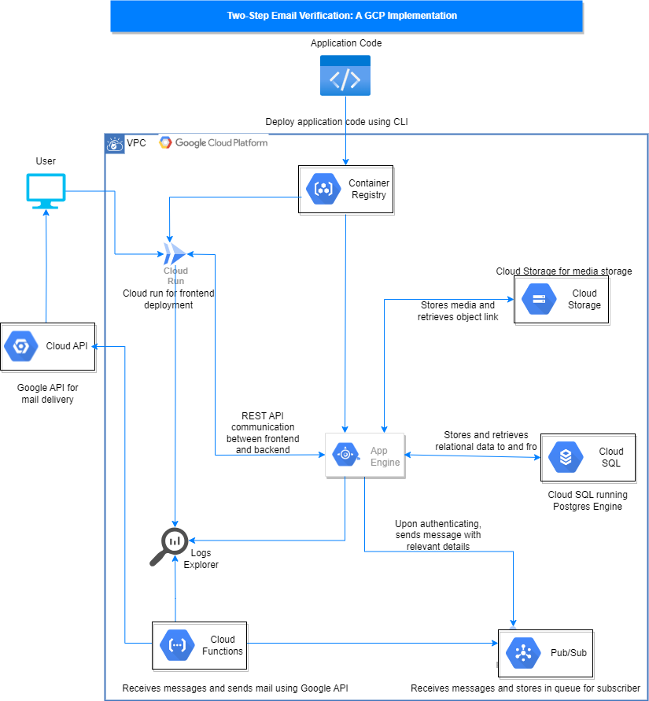
Implementation Block Diagram

Slide 16
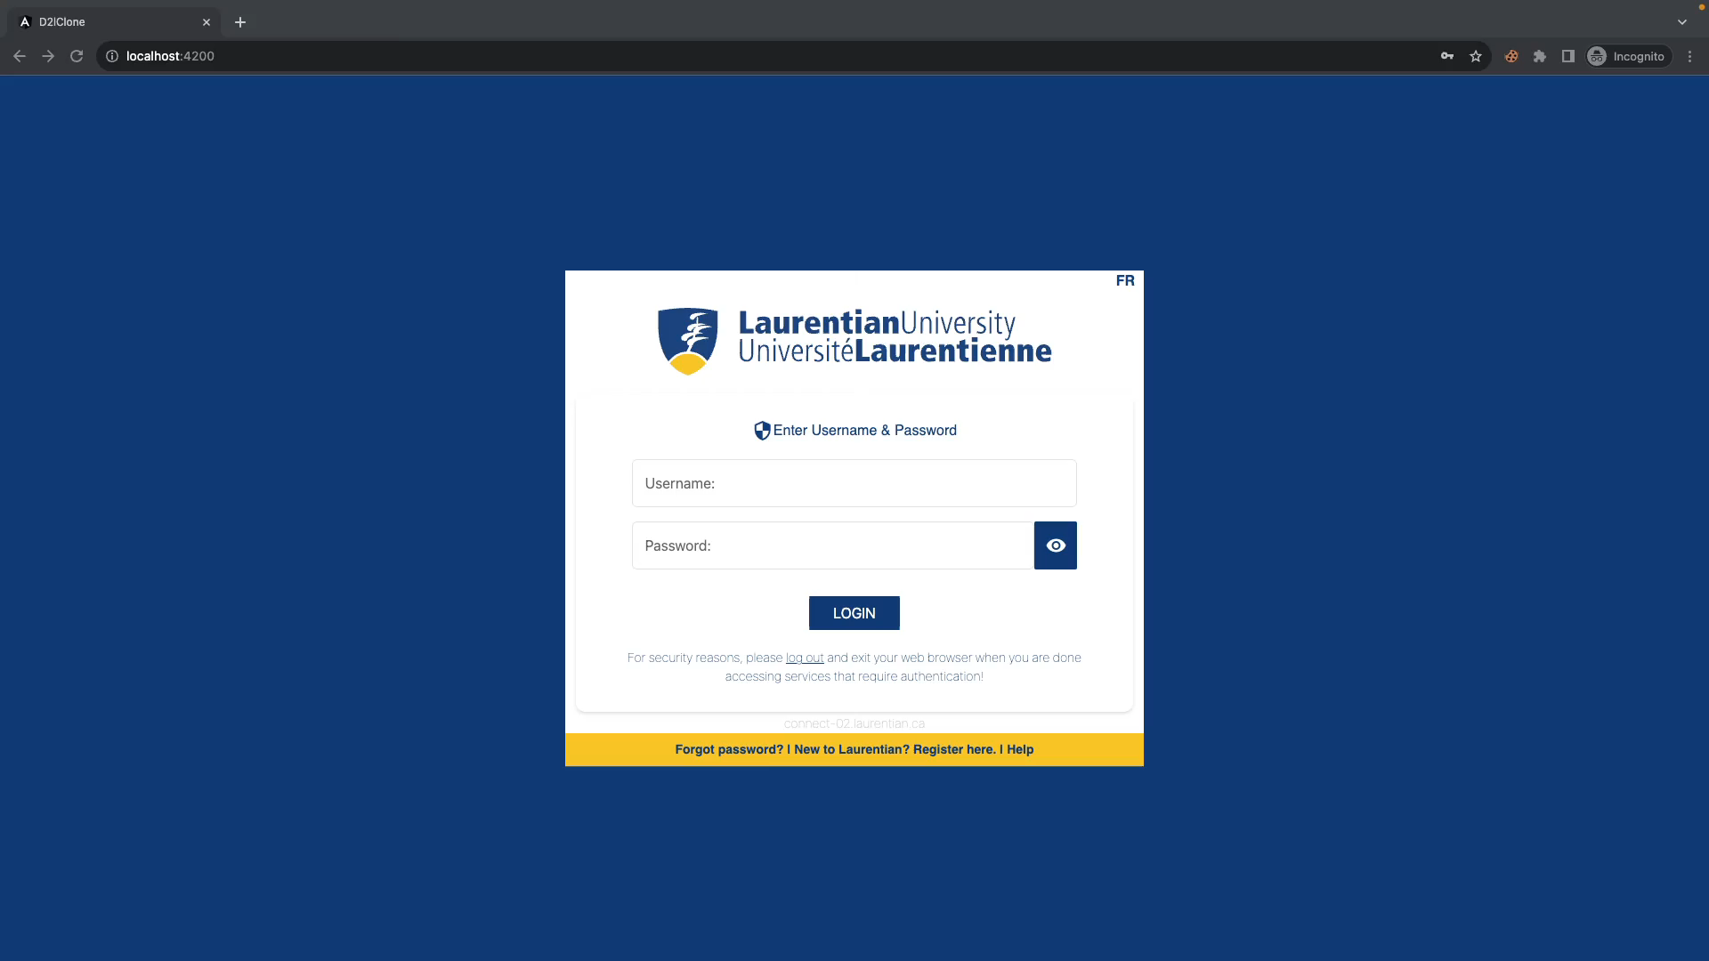
Project Demonstration Video

Slide 17
Future Work: Scalability and Cost
Expansion of Cloud SQL to Multi-Regional:
Objective: Improve data redundancy, availability, and access speed.
Enhanced fault tolerance through data replication across multiple regions.
Improved user experience with lower latency for a broader user base.
Transition to Kubernetes Engine:
Objective: Enhance scalability, orchestration, and resource management.
Streamlined containerized application deployment and scaling.
Improved resource utilization and management.

Slide 18
Future Work: Integration of Machine Learning
Integration of Machine Learning for Image Validation:
Objective: Strengthen security by validating user-uploaded images.
Enhanced authentication by validating the authenticity of user images.
Mitigation of potential security risks associated with manipulated images.

Slide 19
Achievements and Impact:
Successful Implementation of 2FA
Two-Factor Authentication (2FA) system implemented effectively.
Improved security posture by adding an additional layer of verification.
GCP Services Integration
Seamless integration of GCP services: Cloud SQL, App Engine, Pub/Sub, and Cloud Storage.
Demonstrated the power of cloud-native architecture in securing user authentication.
Enhanced User Experience
Streamlined user interaction with a secure and user-friendly 2FA process.
Positive impact on user trust and confidence in the authentication system.

Slide 20
Challenges and Lessons Learned
Scalability Challenges
Challenges related to scalability, especially during peak usage.
Highlighted the importance of addressing scalability for future success.
Cost Estimation Insights
Utilized GCP's Pricing Calculator for accurate cost projections.
Real-time updates and service-specific breakdowns provided valuable insights.
User Privacy and Compliance
Emphasized the significance of maintaining user privacy and complying with ethical standards.
Acknowledged the importance of simulated interactions to ensure data confidentiality.

Slide 21
Project Impact and Acknowledgments
Contributions to Online Security
Overall impact on enhancing online security practices through 2FA.
Contribution to the adoption of robust authentication mechanisms.
Thank You and Acknowledgments
Special Thanks to Professor Jaspreet Bhatia for Invaluable Guidance.
Gratitude to the project team for their dedication and hard work.

Slide 22
Thank You

